Slide 1


Decoding Startup Success
By: Joyce Ghosn| April 2025

Slide 2


Story Map
From Data to Insight: The Journey of Smarter Startup Evaluation
Dataset & Scope
Key Question & Main Conclusion
Investment vs Growth
Efficiency & Valuation
Geography’s Hidden Power

Slide 3



Slide 4

What If the Most Funded Startups Aren’t the Most Successful?
.
Billions of dollars flow into startups every year. But does more funding mean more growth?

Slide 5

No

Slide 6

01
High funding doesn’t guarantee strong performance — many startups grow efficiently despite receiving less capital.
02
Investor perception (valuation) often inflates sectors that are actually underperforming.
Here’s What the Data Revealed…
No industry leads forever — performance shifts over time, making it risky to rely on just one sector
03
04
Some countries quietly outperform global giants by turning limited capital into real growth.
05
Geography plays a major role in industry success.

Slide 7

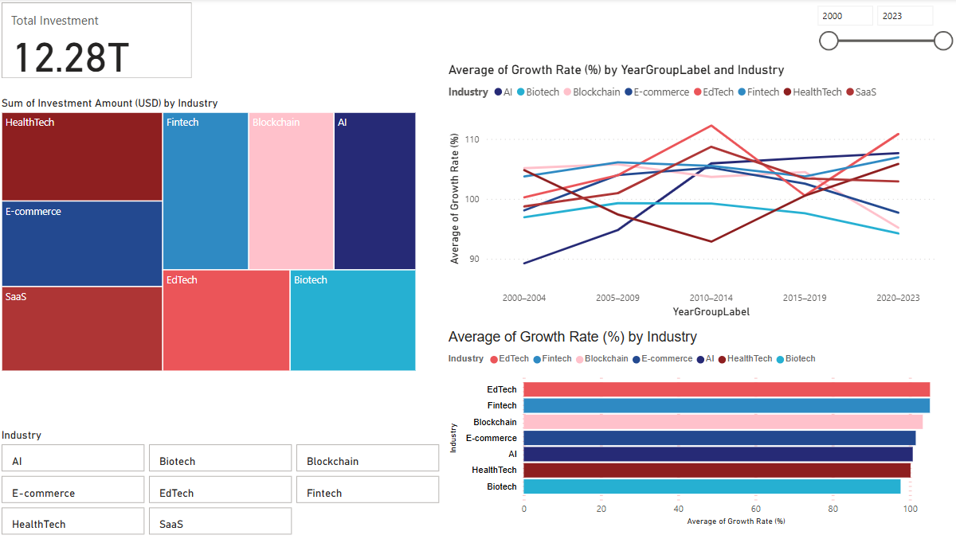
Big Money, But Is It Smart Money?

Slide 8
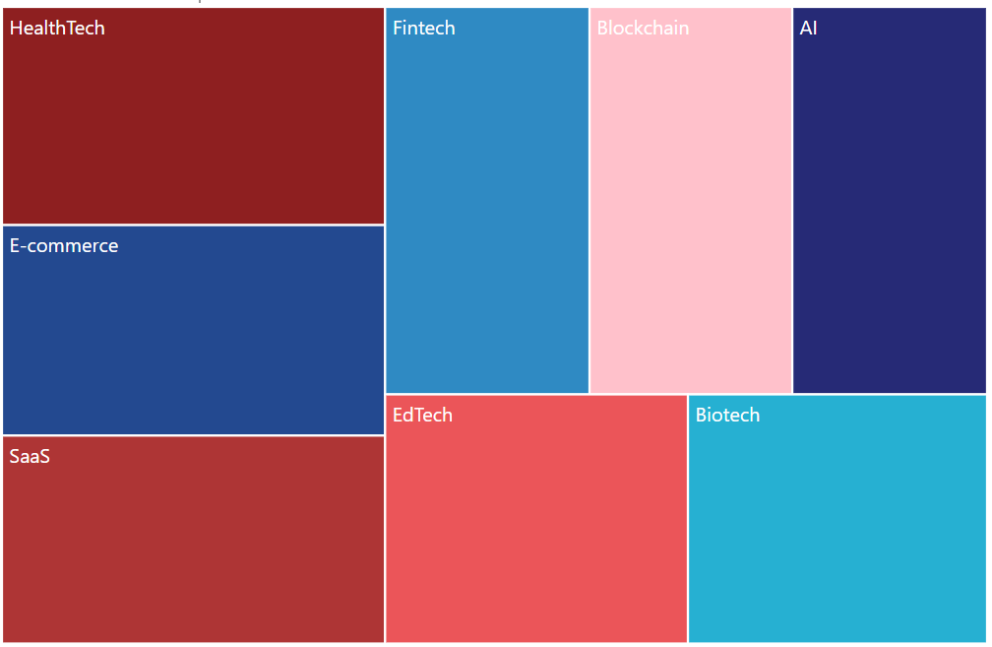
Where Does the Money Go?
HealthTech, E-commerce, and SaaS receive the most funding
Biotech and EdTech attract the least
Capital flows toward digital and scalable sectors
But… does funding reflect performance?

Slide 9
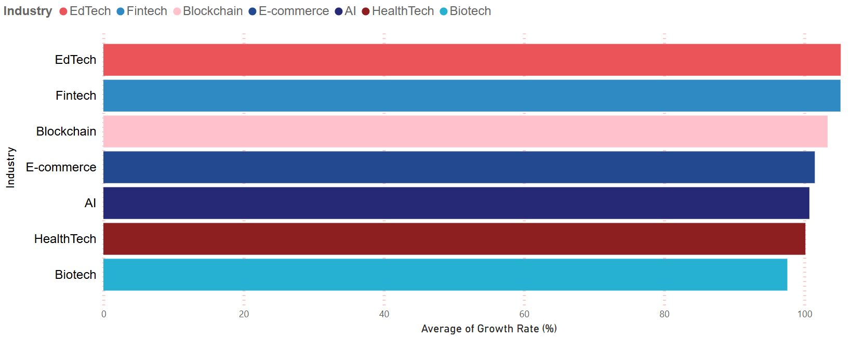
Surprise: Everyone Grows at the Same Speed
Average growth rates are nearly identical across industries
EdTech and Biotech — though less funded — grow just as fast
Funding ≠ faster growth
Lean industries still perform competitively

Slide 10
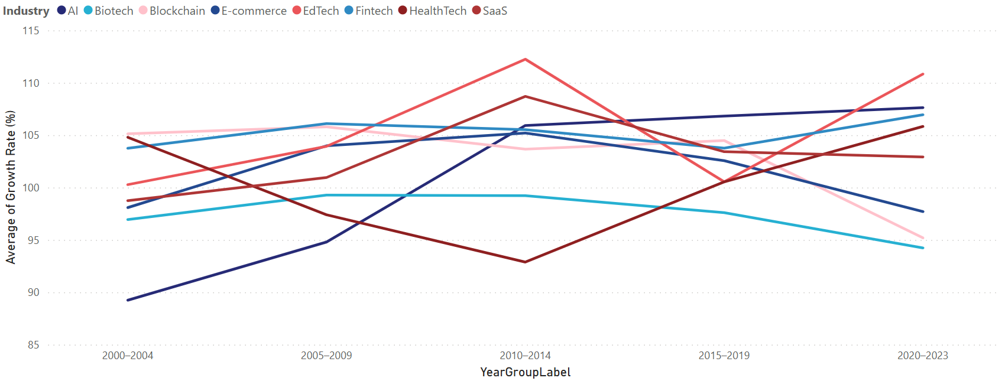
Where Does the Money Go?
EdTech spikes in 2010–2014 and again post-2020
AI shows steady and consistent rise
HealthTech surges post-COVID
Other industries fluctuate unpredictably
Growth rate ≠ stable performance

Slide 11
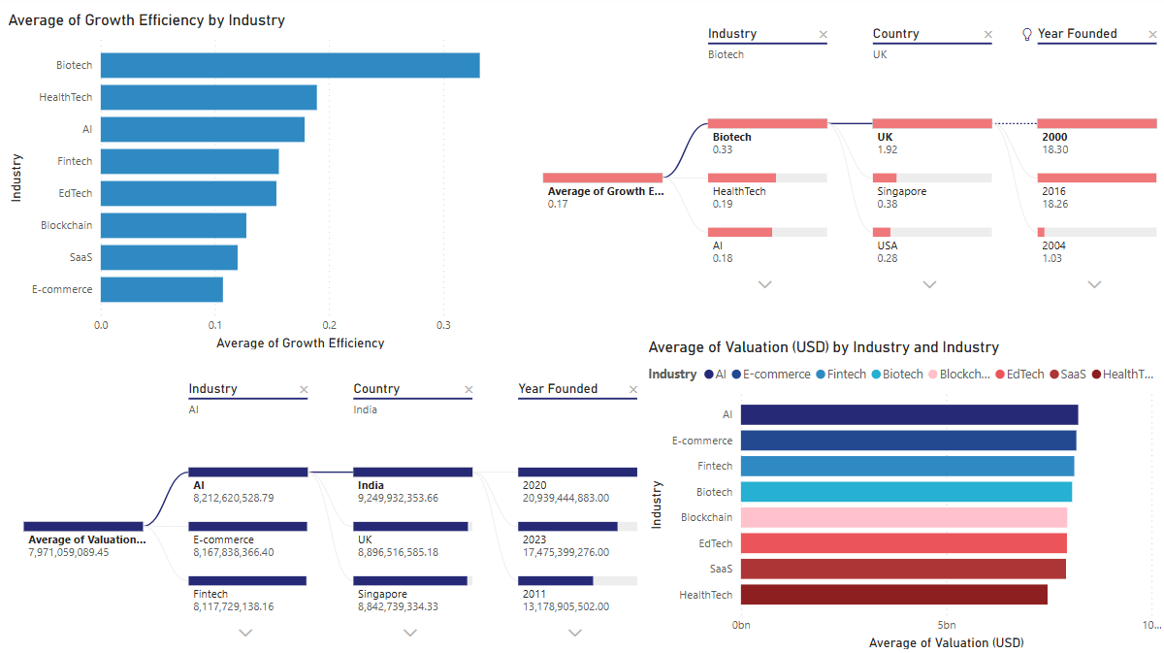
Who’s Growing Smart — and Who’s Just Expensive?

Slide 12
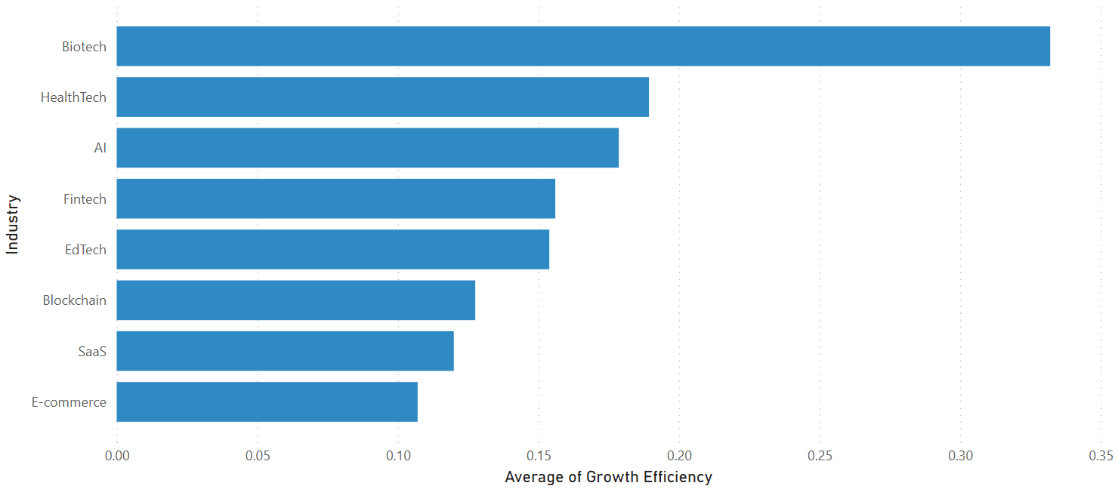
Who Uses Capital the Smartest?
Biotech leads in growth efficiency
HealthTech and AI follow with balanced profiles
E-commerce and SaaS rank lowest
More funding ≠ more performance
Efficiency reveals real value creation

Slide 13
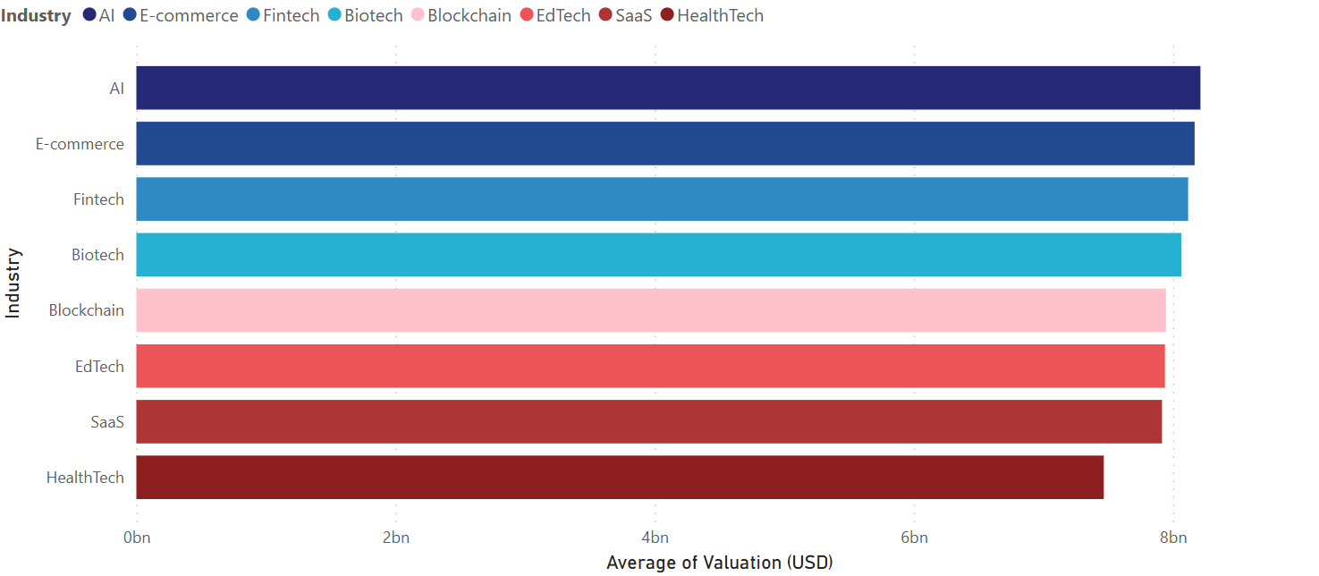
Are Valuations Aligned with Real Performance?
Industry valuations are surprisingly close across the board
AI leads — likely driven by hype and future potential
Biotech ranks 4th despite minimal funding — signaling hidden investor confidence
Valuation ≠ Efficiency → Perception can be misleading
As investors, we must evaluate the whole picture, not just the price tag

Slide 14
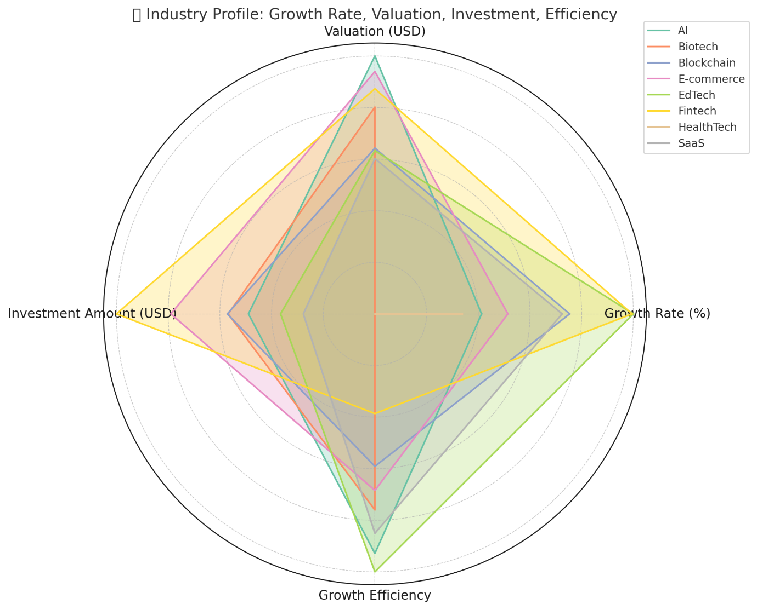
The Full Picture: Balanced or Just Funded
EdTech: high growth & efficiency, low funding
Fintech: high funding & growth, low efficiency
AI: balanced across all dimensions
Biotech: strong efficiency, weaker in other areas
Not all success is well-rounded — funding often drives imbalance

Slide 15


Slide 16
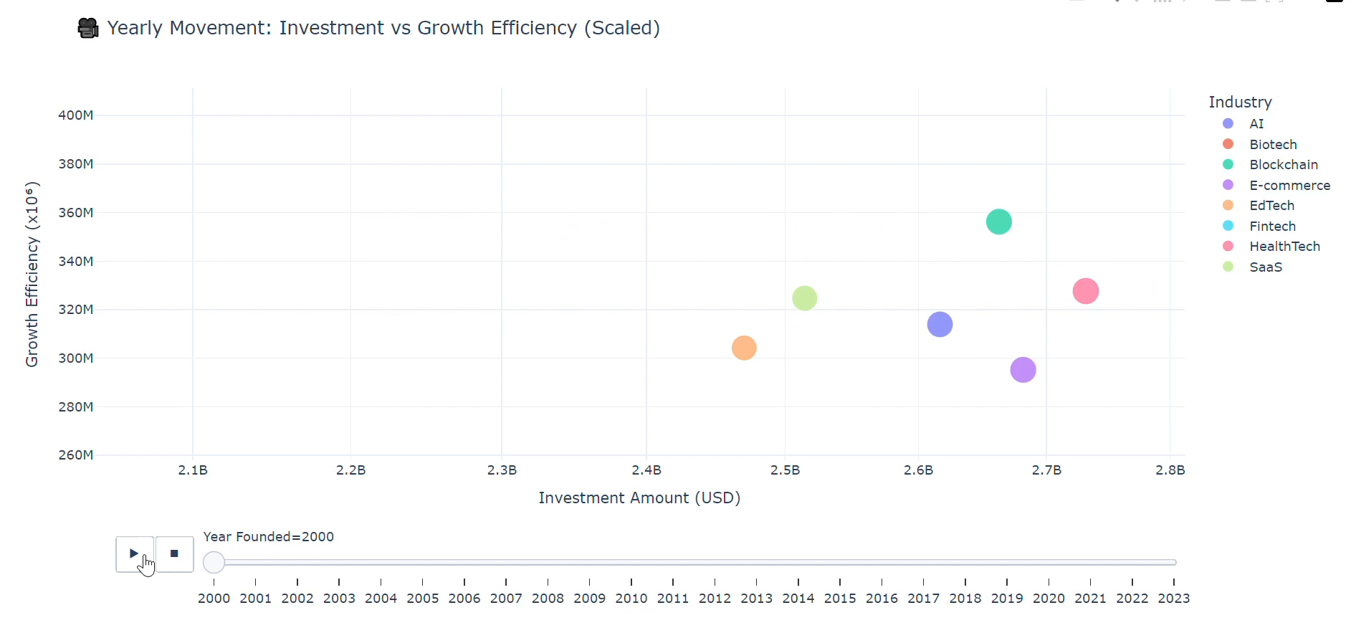
Trends Shift — So Should Your Perspective

Slide 17


Slide 18
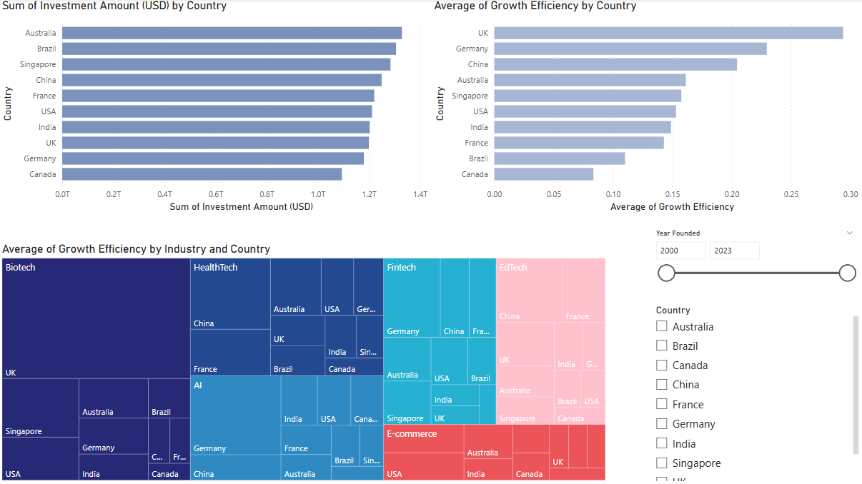
It’s Not Just What You Invest In — It’s Where

Slide 19
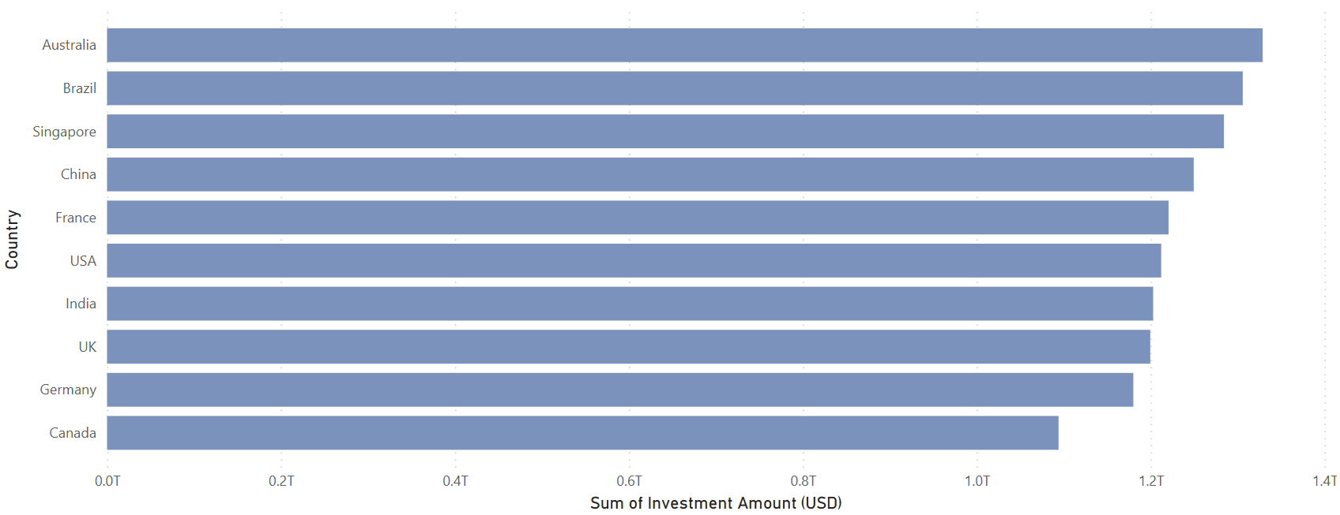
Who’s Getting the Most Capital?
Australia, Brazil, and Singapore lead in total startup investment
USA, UK, and Germany rank lower than expected

Slide 20
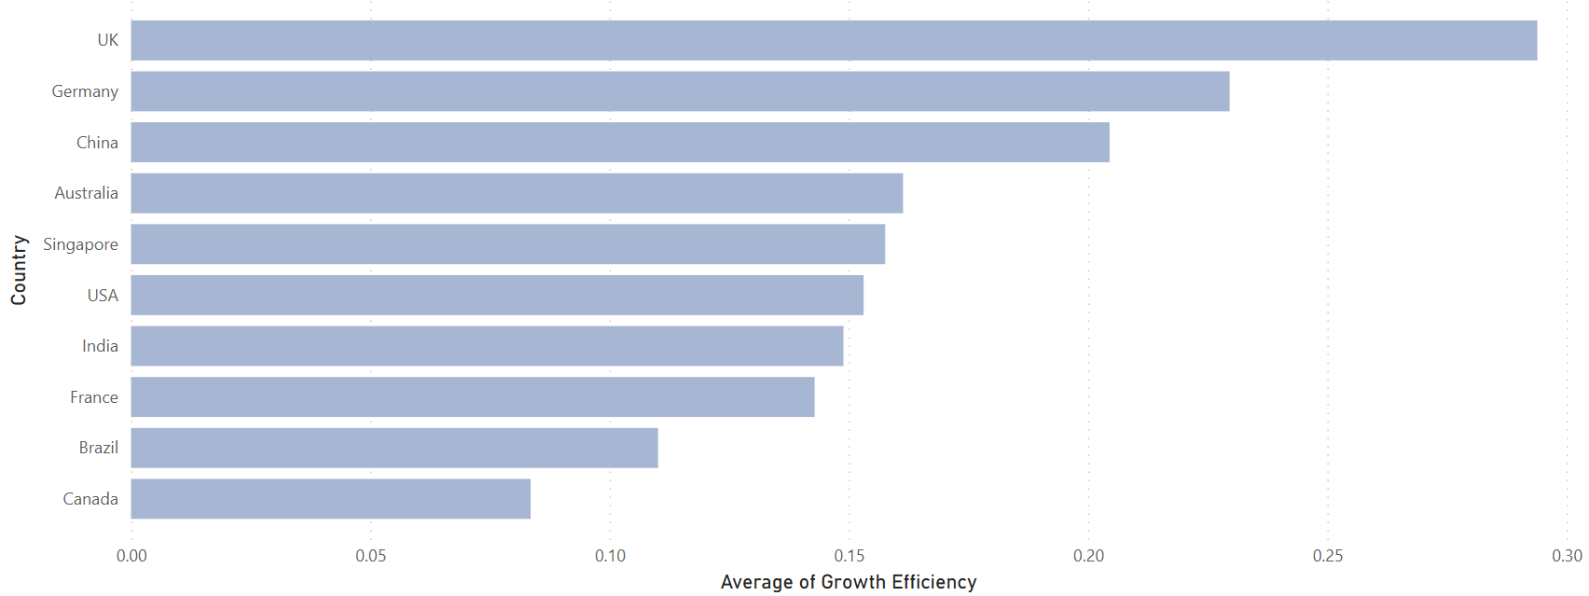
Who’s Using Capital Most Efficiently?
UK leads in growth efficiency
Germany and China follow
Australia sits in the middle of the efficiency rankings
Brazil and Canada rank lowest
Big contrast to the investment ranking

Slide 21
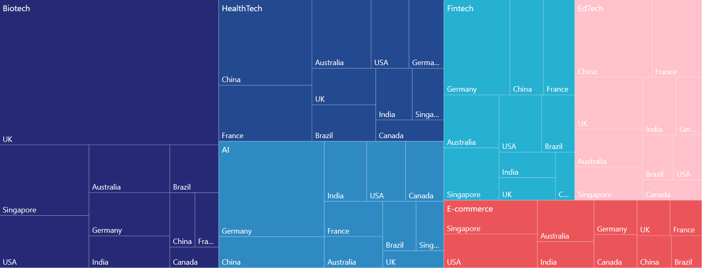
Who’s Using Capital Most Efficiently?
UK dominates Biotech efficiency
China leads HealthTech
Germany drives AI and Fintech
Country-level impact shapes sector success
Industry performance is local, not global

Slide 22
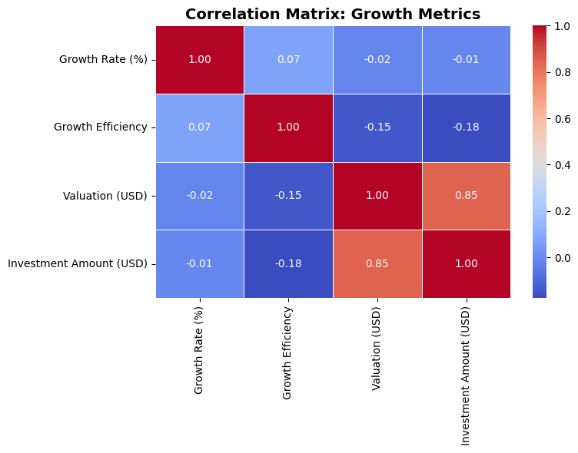
Who’s Using Capital Most Efficiently?
Strong correlation between investment and valuation (0.85)
But efficiency? No real link to money or valuation
More capital ≠ smarter growth
Insight confirmed — statistically

Slide 23


THANK YOU!

